Slide 1

Information for
Year 12 students, 2025
Notes:
This presentation is provided by TISC to assist Year 12 students understand some of the things they need to know in relation to the TISC application process. Teachers may use or hide slides as necessary.

Slide 2

In this presentation
About TISC
Entry requirements
About the ATAR and how it’s calculated
Marks adjustment processes
Application process
Results
Offers
Notes:
In this presentation, we will talk about what TISC does, entry requirements into university in Western Australia, the ATAR and marks adjustment, how to apply and what to expect at the end of the year with your results and offers. There is a lot of information, and if you get a bit lost, you can refer to the full presentation on our website and select the sections that are most relevant to you.

Slide 3
Who is TISC and what do we do?
TISC calculates scaled scores and ATARs.
We also broadly manage the undergraduate university admission process, particularly for WA Year 12s.
We publish the TISC Guide and other brochures.
We conduct information presentations – like this one – for school groups.
We run the Skills for Tertiary Admissions Test (STAT).
Owned by the four public universities but are a neutral body.
Aim to enhance participation in Higher Education.
Notes:
TISC is owned by the four public universities in Western Australia, and manages domestic undergraduate admissions for all five WA universities. We also look after the calculation of scaled scores and ATARs.
We also publish various documents like the TISC Guide, to help people understand university entry, visit schools to provide presentations like this one, and run the Skills for Tertiary Admissions Test. STAT is designed for mature-age students, but there are some situations in which Year 12 students might need to sit it.
Although we are owned by the universities, we are a neutral body and will not advise students on specific course or university choices. One of our aims is to enhance participation in Higher Education across the state.

Slide 4
www.tisc.edu.au
Courses database
Uni application
ATAR
Offers
Information
Links
Notes:
Check the TISC website before you are ready to make your application, make sure you know your way around it and what information it contains, and check the links to related sites. There is a lot of information available to you if you know where to find it.
Use TISCOnline to research the courses available, apply for a university place, change your preferences, check your application, find out your Year 12 results and your ATAR (current WA Year 12 only), see if you have received an offer, and find more information. The course database is updated between March and April each year.

Slide 5
Entry requirements
Notes:
The following slides summarise the entry requirements for standard direct entry into undergraduate degrees in WA universities. Some courses will allow entry on other criteria (such as audition or portfolio) as well as or instead of the ATAR requirement. Each university can set their own entry requirements, but they tend to have things in common.

Slide 6

Pathways to university
ATAR
IB Diploma
VET studies – Certificate IV or higher
Portfolio or experience-based entry
Enabling programs
Notes:
Many Year 12 students who enter university do so by completing courses that end up with them getting an ATAR. This is still the most direct path and the best way to prepare yourself for the realities of university studies. Later in this presentation, we will talk about what an ATAR is and how it’s calculated. If you study the IB Diploma instead of WACE, you will have a rank worked out so that you can be compared alongside ATAR students.
Other students will qualify for university entry by completing vocational studies at Certificate IV level or higher.
Some courses will allow you to submit a portfolio of work that will be considered alongside, or sometimes instead of, an ATAR, or give consideration to other life experience.
Finally, most universities offer enabling programs that enable you to complete a six-month course that will qualify you for entry to that universities’ courses. Some schools also offer these enabling programs as part of your Year 12 studies. While many universities recognise other universities’ enabling programs, it is generally recommended to apply for the enabling program offered by the university where you hope to later study your degree. Enabling programs don’t give direct entry to all bachelor degree courses, as some have additional requirements.

Slide 7

University Admission Requirements
(WA Year 12 Students)
WACE or IB Diploma
English
Prerequisites
ATAR or Selection Rank or
IB Admissions Score
Notes:
As we said earlier, universities can set their own entry requirements, but generally you need to satisfy four basic requirements to get directly into degree-level studies at university.
To maximise your options, you should achieve the WA Certificate of Education. Your school will be helping you to do this. For the majority of people, this isn’t a huge problem. If you don’t achieve WACE, you should talk with the university you wish to attend, to see what course of action you need to take. Some universities have more flexibility on this requirement than others.
Everyone needs a certain level of English proficiency to cope with university study, and each university sets an English Language requirement. We will talk about this on the next slide.
Prerequisites are courses you need to have passed in Year 12 in order to successfully complete certain courses at university. Many university courses do not have any prerequisites. If you don’t meet the prerequisites for a course you want to do, talk with the university to seek their advice on possible bridging units you can take while you’re at university.
Finally, of course, you need some kind of academic runs on the board, so that universities can be confident that you’ve got a good chance of completing the course. As we said earlier, for most people this will be their ATAR, but other demonstrated academic performance may also be considered.

Slide 8


English Language Competence (ELC)
ATAR English (or Literature or EALD)
General English (or Literature or EALD)
Scaled score of 50.00 or higher – ELC for all universities
Near miss – TISC may concede ELC for one or more unis
Final school grade of C or higher – ECU and Curtin
Any result (with Yr 12 completion) – Murdoch and Notre Dame
If scaled score <50, will be invited to sit STAT in January for English competence.
Any result (with Yr 12 completion) – Murdoch and Notre Dame
Final school grade of A – Curtin.
Final school grade of A and a Certificate IV – ECU (Experience-based Entry pathway only)
UWA – you will need to have a letter giving you permission to sit STAT for English competence. You won’t be permitted to sit before the WACE exams end.
Notes:
English Language competence can cause confusion for students, because each university has different rules.
The best way to achieve English competence is to get a scaled score of 50.00 or higher in an ATAR English subject (this includes Literature and English as an Additional Language/Dialect). This will give you an excellent preparation for the research, reading and writing requirements of your university degree.
If you take an ATAR English subject and don’t quite achieve a scaled score of 50, the TISC system may be able to concede English competence if you have come close, based on rules set by the universities. Curtin and ECU will also give you English competence if your final school grade is a C or higher. Murdoch and Notre Dame award English competence based on completion of Year 12 in Western Australia rather than specific subject results. If you want to go to Curtin, ECU or UWA and don’t get English competence based on your ATAR English results, you will be invited to sit the Special Tertiary Admissions Test (STAT) in January as a second chance.
If you are taking a General English subject, again, Murdoch and Notre Dame will award English competence if you complete Year 12 in WA. ECU will award English competence for their Experience Based Entry Scheme, if you get a final school grade of A in English and complete a Certificate IV. Curtin will award English competence for standard entry with an A grade in General English. For UWA, you may be allowed to sit STAT in November or January, but this isn’t automatic – you’ll need to check with the universities or TISC closer to the time to see if you need a special permission letter.
Successful completion of UniReady in Schools or UniPrep in Schools will also meet English language competence requirements for Curtin and ECU.
Portfolio and alternative entry pathways may have more flexible English competence requirements – check with the universities for more information.

Slide 9
English Language Competence for VET students
AQF Diploma: will meet ELC for all WA universities
AQF Certificate IV plus ATAR English (or Literature or EALD):
  Will meet ELC for Murdoch and Notre Dame
  Will meet ELC for Curtin and ECU if you get a final school grade of C or higher or a final scaled score of 50.00 or higher.
  Will meet ELC for UWA if you achieve a final scaled score of 50.00 or higher – but may not meet their minimum entry requirements – contact UWA for details.
  Will be able to book STAT Written English in January if ELC not achieved.
Notes:
[Use this section only for presentations with a large cohort of VET students]
For Year 12s who are taking a VET pathway to university, if you successfully complete an AQF Diploma, this will meet English competence for all universities.
If you complete a Certificate IV, achievement of English competence will depend on the university you wish to study at, and your results in either ATAR or General English. Bear in mind that you also need to meet the university’s minimum entry requirement.

Slide 10
English Language Competence for VET students
AQF Certificate IV plus General English (or Literature or EALD)
  Will meet ELC for Murdoch and Notre Dame.
  Will meet ELC for ECU’s Experience Based Entry Scheme if your final school grade is A.
  Will meet ELC for Curtin if your final school grade is A (or B for Portfolio Entry).
  Will not meet ELC for UWA.
  You may be permitted to sit STAT Written English after the completion of WACE exams to meet ELC for Curtin and ECU.
  If you want to study at UWA, you will need written permission from UWA to sit the full STAT.
Notes:
[Use this section only for presentations with a large cohort of VET students]
If you complete a Certificate IV, achievement of English competence will depend on the university you wish to study at, and your results in either ATAR or General English. Bear in mind that you also need to meet the university’s minimum entry requirement.

Slide 11
English Language Competence – Enabling Programs
In most cases, successful completion of a university enabling program (eg UniReady, UniPrep Schools, UniPath, TLC Learning for Tomorrow or FlexiTrack High) will also satisfy university English competence requirements.
There may be some exceptions – TISC recommends checking with the university where you wish to study for confirmation.
If you don’t meet ELC via your enabling program, the requirements for ATAR/General English will still apply.
Notes:
[Use this section only for presentations with a large cohort of VET students]
If you complete a Certificate IV, achievement of English competence will depend on the university you wish to study at, and your results in either ATAR or General English. Bear in mind that you also need to meet the university’s minimum entry requirement.

Slide 12
International Baccalaureate (IB)
To apply for university in WA, register as a new user on TISCOnline.
Declare your IB studies under the Secondary Studies question (choose “IB” as your location, not “WA”)
It’s important to give us your correct IB personal code (format abc123)
Check with your school IB DP Co-Ordinator that your results will be released to TISC.
We expect IB students to be included in Main Round offers again this year.
Notes:
[Use this section only for schools with IB students]
If you are studying the International Baccalaureate, you can also apply through TISC – you will need to register as a new user. Make sure that you declare your IB studies under Secondary Studies and give us your correct Personal Code.
We expect that IB students will be included in the main round of offers again this year, but if there are any delays in your results – for example if you gave the incorrect information or did not request IB release your results to TISC – then this may not be possible. There will be very limited time to change your preferences once IB results are released.

Slide 13
What’s an IB Admissions Score?
Your IB score is reported as a whole number (max. 45).
However, you will also receive a finer-grained conversion to an IB Admissions Score (IBAS). This utilises more data points to give a more accurate picture of your performance within the IB score band.
Tertiary Admission Centres (TACs) like TISC will then convert these to a Combined Rank according to an agreed national schedule.
The Admissions Requirements brochure for IB students gives more information.
If you apply through TISC, TISC will inform you of your IBAS.
Notes:
[Use this section only for schools with IB students]
Tertiary Admissions Centres across Australia have introduced a new step in converting your IB Diploma score into a comparable rank (known as a Combined Rank) for the purposes of university entry in Australia.
You will still receive your whole number IB Diploma score as part of your official results from the International Baccalaureate Organisation. The TACs will also receive finer-grained data from IB which will determine your IB Admissions Score (IBAS).
If you have applied for university through TISC, or registered as a new user on our website, TISC will contact you by email to advise you of your IBAS, shortly after IB results are available.

Slide 14
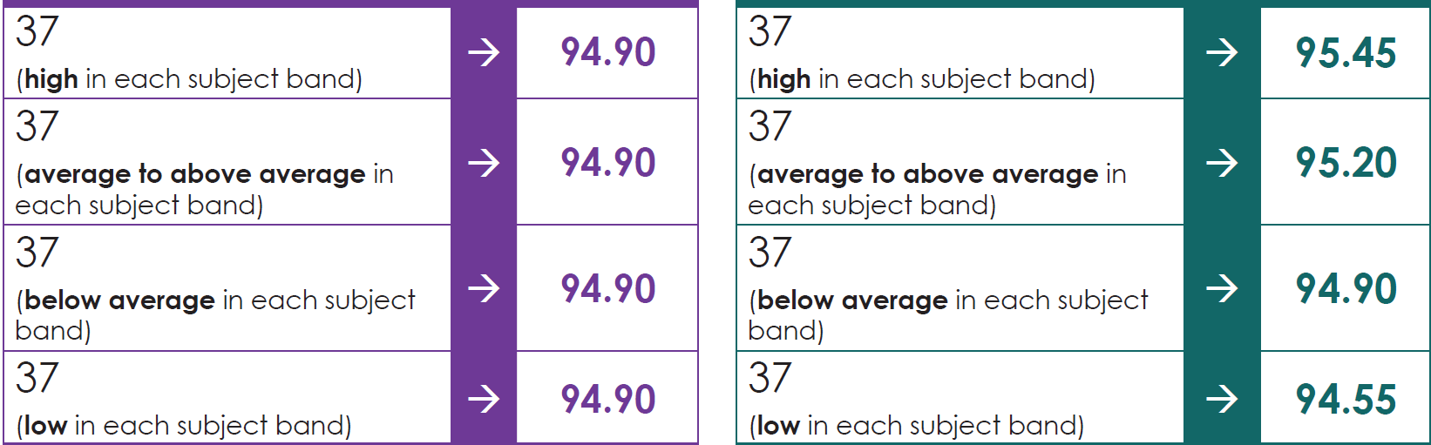
What’s an IB Admissions Score?
Conversions are examples only.
Old system
Using IBAS
Notes:
These tables show how using an IBAS rather than the whole-number Diploma Score may affect the Combined Rank outcome. The majority of IB students will be awarded a higher Combined Rank using the IBAS than they would have under the old system.

Slide 15
The ATAR
Notes:
You’ll hear a lot about the ATAR this year, so it’s worth spending a bit of time talking about what it means.

Slide 16
75
Notes:
Let’s say you achieved a score of 75 in a test. Would you be happy or not so happy with that score?
It may depend on how well everyone else has done in the same test.

Slide 17
75
0
100
20
80
70
100
Notes:
Let’s think about this some more. Generally, we think of a score in the context of a zero to one hundred scale. In this case, 75 is a pretty good score, towards the top of the possible achievement levels. (Top scale)
If the range of marks achieved in the test was from, say, 20 to 80, then the 75 looks even better. It’s almost the very top score.
On the other hand, if people in the test achieved scores ranging from 70 to 100, then the 75 isn’t looking so great. It’s towards the bottom of the range of marks – perhaps this was a less challenging assessment.
So, sometimes a number by itself doesn’t give a complete picture. We need to look at one person’s level of achievement in the context of how well other people have done, if the purpose is comparability.

Slide 18

ATAR
Australian Tertiary Admission Rank
Notes:
ATAR stands for Australian Tertiary Admission Rank.

Slide 19
A way to compare the results of thousands of students for university entry purposes.
Rank position in the total WA Year 12 school leaving age population.
75.00 means you have performed better than 75% of all the Year 12 school leaving age people in WA.
87.30
97.30
86.90
73.50
76.95
80.05
79.00
64.80
79.25
65.75
59.70
Notes:
Assessing students for university entrance is, in many cases, a comparative process. The ATAR is a way in which we can express that comparison. It allows universities to compare results from a wide variety of students and courses in a way that’s as fair and efficient as possible in a fairly short space of time.
Your ATAR is a rank position in the total WA Year 12 school leaving age population, not just people enrolled in Year 12 or taking ATAR subjects – therefore an ATAR of 75.00 means you performed better than 75 per cent of all people your age in Western Australia.

Slide 20
ATAR isn’t the only selection tool.
Interview
Audition
Test
Portfolio
School Recommendation
87.30
97.30
86.90
73.50
76.95
80.05
79.00
64.80
79.25
65.75
59.70
Notes:
Of course, no single measure is perfect, so it’s not uncommon for the ATAR to be supplemented, or even sometimes replaced by other selection tools, such as auditions, interviews, aptitude tests, presentation of portfolios or recommendation from a school. It’s also important to remember that your ATAR is not intended to be a measure of how hard you worked, or how good you are at your chosen subjects – it’s simply a comparison tool.

Slide 21
Your ATAR is valid
across the
country.
Notes:
One of the good things about the ATAR is that, even though high school education is a bit different in every state, because we all work out our ATARs comparing individuals to the state’s population, ATARs can be used in any other state. That means you can use your WA ATAR for entry to universities anywhere in Australia. It’s also recognized internationally.

Slide 22
From raw marks to scaled scores
Notes:
The first step in the ATAR calculation process is to calculate your scaled scores. We’ll spend a bit of time now taking you through how we get there from your raw school and exam results.

Slide 23

























84.7
76
58
99.2
65
17.9
47.6
50.3
Notes:
The challenge for TISC is that we need to add together results that are achieved from several hundred different schools, of all sizes and characteristics. We’re also needing to somehow – fairly – compare results from vastly different courses. How do you compare a 65 in Drama with a 65 in Mathematics Specialist?
It’s about comparison of how well you’ve done against how well everyone else has done (remember, that’s what the ATAR means).
So, everything we do to your marks is so that we can complete this comparison process as fairly as possible.
We understand that you might not like what we do to your marks. Remember that these processes are applying to every single person who sits ATAR exams, so we’re not just picking on you!
And it’s not because we thought your performance wasn’t good. The only reason we do this is so we can add together numbers that come from very different contexts.

Slide 24
Marks adjustment processes
Context | Comparison
Schools | Moderation
Exams | Standardisation
Courses | Scaling
Notes:
Marks from exams and school assessments go through a few adjustments before they are added together to form the TEA. The adjustments are designed to take account of the various contexts in which marks are achieved, to make sure that the system provides a fair comparison for everyone.
Moderation
Moderation enables comparison of school marks achieved in all the different schools that offer WACE subjects.
Standardisation
Standardisation makes sure you’re not disadvantaged if you happen to strike a particularly difficult exam paper at the end of the year, and that other people who might have a relatively easy paper in their subject don’t get an advantage over you. It also ensures comparability between years – you may be competing for a place against someone who sat their examination/s in a different year that had a relatively easier exam paper.
Scaling
Scaling takes into account that some subjects attract academically-stronger students than others. That means the academic competition in some courses is tougher than in others. Scaling makes sure that, if you’ve achieved your marks in a course competing against high-achieving students, that context is recognised.

Slide 25
Marks adjustment processes
Exam marks
Average Marks Scaling
Course combined marks
Standardised combined marks
Scaled
scores
School marks
Moderated school marks
Schools
Exams
Courses
Notes:
This diagram gives you the full picture of what happens to your marks. We start over on the left, with your raw school marks – this is what your school submits to SCSA once you have completed everything up to (including) your trial ATAR exams.
Your school mark is moderated – to ensure fair comparison across schools – and that Moderated School Mark is added to your raw mark from your WACE exam. This gives you a course combined mark.
The course combined mark is then standardised – to ensure fair comparison across different years and subjects with relatively easy or difficult exam papers – to give you a Standardised combined mark.
The standardised combined mark goes through the Average Marks Scaling process, which then generates a scaled score.
We will now go through each process in some more detail so that you understand why they are applied.

Slide 26
Moderation
School A – Subject X
School B – Subject X
School assessment
Exam
School assessment
Exam
Notes:
[Hide these slides if time is limited]
Moderation checks and makes adjustments so that students aren’t disadvantaged if they have had a fairly tough marking teacher, and don’t gain an advantage over other students if their subject teacher has been a generous marker.
Here’s how it works. Let’s say we’ve got two groups of Year 12 students studying exactly the same course, but in two different schools. At the end of the year, the schools submit their subject marks to the School Curriculum and Standards Authority. We’ve represented the range of school marks the students were awarded by the red bar, with the red line representing the average mark for the class.
In this example, it looks like the students in School A have done better in this subject than the students in School B. The range of marks in School A is higher, and the average is higher than School B. Is that because the people in School A are smarter, or better at this subject than the School B students? It might be, but we don’t know until we compare it to something that the students have in common.
That something in common is the external exam. No matter which school you go to, everyone in WA sits the same WACE exam for a subject each year.
So the moderation process compares how the group of students taking a course in each school perform in the exam to how they’ve been marked by their subject teachers. Here, the people in School A haven’t done as well, on average, as the people in school B. So perhaps the teacher in school B was quite a tough marker, and that’s why their results were lower than School As.
If we didn’t do something, the people in School A would have an advantage over the people in School B, not because they actually performed better, but just because of the different marking approaches within their schools. That wouldn’t be fair.

Slide 27
Moderation
School A – Subject X
School B – Subject X
School assessment
Exam
School assessment
Exam
Notes:
So, using the average and spread of each school’s exam marks in that subject, the group’s overall school results are adjusted to match the average and spread (mean and standard deviation) of the examination. This is done on a group level. It doesn’t mean that your individual school mark changes to match your exam mark.
Now we should point out that subject teachers spend a lot of time out of the classroom through the year, working with other colleagues teaching the same subject to check that they’re marking to similar standards, so usually these kind of adjustments are fairly minor.
We’ve exaggerated the degree of movement throughout this presentation, just so it’s a bit easier for you to see what we’re trying to explain.

Slide 28
Combined Marks before Standardisation
60
Course
A
B
C
D
E
F
G
H
I
J
Notes:
Standardisation and Scaling compare performance in whole courses, not in individual schools.
While exams are written by experienced educators, pitched at a particular level of difficulty, we know that sometimes they may be easier or more difficult for students than in other years.
Also, because the results from students in some course exams may all be fairly high compared to some other subjects (and because the exam influences the moderation outcomes), you could have courses where the average at this stage is 70 or more, and others where the average is only in the 50s. The students with the higher scores therefore have an advantage.
Some people might think that courses with high-achieving students in them should have higher average marks. But it doesn’t always work like that. A course filled with high-achieving students might produce an average exam mark of around 57, and another course taken by a group of students with lower overall levels of achievement could end up with an exam mark of 65. If we didn’t do something, this could be unfair.

Slide 29
Combined Marks after Standardisation
60
Course
A
B
C
D
E
F
G
H
I
J
Notes:
So, to make sure no-one is advantaged or disadvantaged, depending on whether their course exam happened to be a bit easier or harder than others, the standardisation process adjusts the average of each course’s combined marks and the spread of combined marks to be similar to one another (an average of 60).
Remember, this is all about comparisons, so this process ensures that the person who’s ranked in a certain position of achievement in one subject has combined marks that are comparable to other students in other courses who are at a similar rank.

Slide 30
Average Marks Scaling Process
50
35
59
75
37
62
55
53
48
51
68
82
75
73
90
81
56
70
79
66
68
75
68
44
69
57
63
60
80
77
79
62
49
23
53
55
61
78
84
75
60
73
41
53
54
58
61
55
57
55
60
62
57
Course A
Course B
Notes:
The official process we use for scaling is called ‘Average Marks Scaling’ or ‘AMS’.
This is not really about whether a course is ‘hard’ or ‘easy’. It’s a comparison of the levels of academic competition within each course. (It’s like coming 3rd in a national athletics competition compared to coming third in your local school carnival. The overall level of competition is a bit different in the two contexts.) The reason this is important is because, after standardisation, the average in each course is 60 – if we look at maths subjects which are easily comparable, the average in Specialist is 60 and the average in Applications is 60. I think we can all agree that this would not accurately reflect the academic challenge of each course.
How do we determine what the level of competition is like? High-achieving students, on average, tend to achieve well across most of their other subjects, too. So, we look at how all the people who take a particular course have performed across all their other courses to see how academically able the overall group in a course is.
In this example, we’ve got just two courses, for which the average and range of marks look pretty similar after Standardisation. How well did each group do across their other subjects?

Slide 31
Average Marks Scaling Process
58.5
65.8
50
35
59
75
37
62
55
53
48
51
68
82
75
73
90
81
56
70
79
66
68
75
68
44
69
57
63
60
80
77
79
62
49
23
53
55
61
78
84
75
60
73
41
53
54
58
61
55
57
55
60
62
57
Course A
Course B
Notes:
The AMS process looks at the average scores of the students each course across all their other subjects (it all happens at once).
In this very simplified version, you can see that the overall achievement for the group of students who took Course A is 58.5, which is slightly lower than the standardised average of their results for course A (60). For the students doing course B, the average of their other courses is slightly higher (65.8 compared to 60).

Slide 32
Average Marks Scaling Process
58.5
65.8
50
35
59
75
37
62
55
53
48
51
68
82
75
73
90
81
56
70
79
66
68
75
68
44
69
57
63
60
80
77
79
62
49
23
53
55
61
78
84
75
60
73
41
53
54
58
61
55
57
55
60
62
57
Course A
Course B
Notes:
The AMS process will shift the marks in each course, so that the average scaled score for that course corresponds to the average scaled scores achieved across all the students’ other courses.
Course A, which had the slightly lower overall level of achievement (ie: slightly less competitive) has been shifted down slightly, so that its average scaled score becomes 58.5 (from a standardised combined score average of 60). On the other hand, the standardised combined score average in Course B has moved up to become a scaled score average of 65.8, to match the overall achievement of that more academically-competitive group

Slide 33
After Standardisation, before Scaling
60
Course
A
B
C
D
E
F
G
H
I
J
Notes:
After standardisation, things were looking pretty uniform across the board.

Slide 34
After Scaling
60
Course
A
B
C
D
E
F
G
H
I
J
Notes:
But after scaling, the averages for some courses will have been moved up, while others will have moved down. Course averages move up when the people taking that course achieve stronger results across the board, showing stronger academic competition in that course. Other course averages will move down if they are taken by students who don’t achieve quite as well across the board.
Course scaling averages tend to be fairly similar from year to year, not because we’ve decided that’s what will happen, but because they tend to be taken by students of similar ability level each year. The scaling process is never pre-determined; it’s always driven by the actual performance of the students themselves.

Slide 35
Notes:
The other thing to remember is that, in all these processes, you always stay in the same order at the end of the process that you were in at the beginning of the process. We might stretch or contract the range of marks, we might move the range of marks up or down, but you always remain in the same order. If your combined score was the 347th highest in WA in a particular course, your standardised combined score will still be the 347th highest in that course (as will your scaled score).

Slide 36

Calculating the ATAR
Tertiary Entrance Aggregate (TEA)
TEA = best 4 scaled scores
+ 10% of a Language Other Than English
+ 10% of Maths Methods and Maths Specialist
Maximum TEA = 430
Notes:
Now that we have calculated scaled scores for every student in each of their ATAR subjects, we can use those to calculate the ATAR.
The ATAR is derived from the Tertiary Entrance Aggregate (TEA). This score is calculated by adding the best 4 scaled scores, plus 10% of the scaled score of a Language Other Than English (LOTE) subject, if you have completed one and 10% of your scaled scores in either or both of Mathematics Methods and Mathematics Specialist. The maximum possible TEA is 430. [Please note that this calculation is changing from 2028, please check the TISC website for details.]
No course can be counted more than once and there are certain rules to prevent you counting both marks from some courses that are broadly similar (for example, Integrated Science and Chemistry cannot both be counted in the calculation of an ATAR). This doesn’t stop you from studying these combinations of courses, but be aware that only the best score of the unacceptable combination will be counted. The unacceptable subject combination has recently been removed for Maths Applications and Maths Methods, so you can count both these subjects towards your TEA, but Applications and Specialist remains an unacceptable combination.
You can find all the details of unacceptable combinations for particular years by consulting the “School Leaver Admission Requirements” brochure for the year you plan to enter university. Make sure you choose the right version of this document, as requirements can change from year to year.

Slide 37

Course | Scaled Score
Physics ATAR | 67.6
Italian ATAR | 66.5
English ATAR | 55.4
Modern History ATAR | 41.5
Mathematics Methods ATAR | 41.0
Sub-total | 231.0
LOTE bonus | 6.7
Maths bonus | 4.1
Tertiary Entrance Aggregate | 241.8
Notes:
CALCULATION OF YOUR ATAR
Let’s look at an actual example and see how this student’s ATAR might be calculated. This is a hypothetical example, as ATARs are not worked out in advance of results being achieved.
This hypothetical student’s top four scaled scores are counted to form the basis of the Tertiary Entrance Aggregate. They also receive a LOTE bonus of 6.7 and a Mathematics bonus of 4.1 (even though Mathematics Methods is not one of their top four scores).
They achieve a Tertiary Entrance Aggregate of 241.8. Without the bonuses, their TEA would have been 231.0 – in a couple of slides, we’ll show you how this affects their final ATAR.

Slide 38
419.0
417.4
415.6
415.6
413.1
411.6
410.0
409.3
409.1
408.7
407.9
406.3
405.6
404.0
403.7
403.7
403.1
402.5
402.4
401.9
400.8
399.3
397.4
396.5
395.6
395.5
395.1
394.7
394.5
394.2
394.0
393.9
393.3
393.0
392.7
392.3
390.3
390.2
389.8
389.8
389.2
389.0
388.7
388.6
388.1
388.0
387.9
387.6
386.2
385.5
385.1
385.0
384.9
384.6
384.5
384.5
383.3
383.3
383.2
383.1
382.8
382.6
382.4
382.2
382.2
382.1
381.8
381.6
381.6
381.5
381.2
381.1
381.1
381.0
380.9
380.5
380.5
379.6
379.3
379.3
379.1
379.1
378.6
378.4
378.4
378.3
378.1
377.9
377.8
377.7
377.6
377.1
376.7
376.6
376.6
376.4
376.2
375.9
375.8
375.5
375.2
375.0
374.7
374.6
374.4
374.2
374.1
374.0
373.7
373.2
372.6
372.4
371.8
371.7
371.4
371.1
371.0
370.4
370.3
369.6
369.4
369.1
369.0
368.9
368.8
368.7
368.6
368.3
Notes:
Through a formula that takes into account the total number of people your age in WA and the proportion of them that are completing Year 12, we determine how many aggregates are assigned to each ATAR band.

Slide 39
419.0
417.4
415.6
415.6
413.1
411.6
410.0
409.3
409.1
408.7
407.9
406.3
405.6
404.0
403.7
403.7
403.1
402.5
402.4
401.9
400.8
399.3
397.4
396.5
395.6
395.5
395.1
394.7
394.5
394.2
394.0
393.9
393.3
393.0
392.7
392.3
390.3
390.2
389.8
389.8
389.2
389.0
388.7
388.6
388.1
388.0
387.9
387.6
386.2
385.5
385.1
385.0
384.9
384.6
384.5
384.5
383.3
383.3
383.2
383.1
382.8
382.6
382.4
382.2
382.2
382.1
381.8
381.6
381.6
381.5
381.2
381.1
381.1
381.0
380.9
380.5
380.5
379.6
379.3
379.3
379.1
379.1
378.6
378.4
378.4
378.3
378.1
377.9
377.8
377.7
377.6
377.1
376.7
376.6
376.6
376.4
376.2
375.9
375.8
375.5
375.2
375.0
374.7
374.6
374.4
374.2
374.1
374.0
373.7
373.2
372.6
372.4
371.8
371.7
371.4
371.1
371.0
370.4
370.3
369.6
369.4
369.1
369.0
368.9
368.8
368.7
368.6
368.3
99.85
99.75
99.95
99.60
99.70
99.80
99.90
99.55
99.65
Notes:
In this example, you’ll see that the top 15 aggregates were assigned the top ATAR band of 99.95.
We continue this process, until all the aggregates have been assigned to an ATAR.
If people have the same aggregate, they all get the same ATAR.
Remember, these values will be different for your year group, as they’re calculated from scratch every year.

Slide 40
TEA/ATAR Summary Table 2024
FOR ILLUSTRATION PURPOSES ONLY
Minimum TEA | ATAR
402.5 | 99.95
393.0 | 99.90
376.4 | 99.70
345.1 | 99.00
324.6 | 98.00
313.0 | 97.00
303.7 | 96.00
296.4 | 95.00
Minimum TEA | ATAR
269.4 | 90.00
251.4 | 85.00
241.8 | 81.70
237.3 | 80.00
231.0 | 77.15
226.6 | 75.00
216.4 | 70.00
206.9 | 65.00
Notes:
Once all the aggregates have been assigned to ATAR bands, we can publish information that summarises the outcome.
Here, we see that everyone who achieved a TEA of 402.5 or higher got 99.95, and anyone with an aggregate from 393.0 to 402.4 received 99.90.
The person in our example, who achieved an aggregate of 241.8 would have received an ATAR of 81.70 last year.
Remember that none of this is worked out in advance; it’s based on the TEAs that people actually achieve. So the TEA required to achieve a particular ATAR can change from year to year. Please use any of this information as a guide only.

Slide 41

Best 4 average in 2024
Average | ATAR | Average | ATAR
50 | 61.40 | 55 | 71.85
60 | 80.95 | 65 | 87.50
70 | 92.35 | 75 | 95.50
80 | 97.60 | 85 | 98.75
90 | 99.40 | 95 | 99.75
Notes:
Have a look at what can happen with just a slight increase in your average score.
Say you were sitting around a 50 average at the beginning of Year 12. If you managed to increase your average just five points, you’d see a significant jump in your ATAR.
It’s harder to increase your ATAR as you get towards the top of things, but in the 50 to 70 average scaled score range, you can make quite a difference with a bit of improvement.

Slide 42
Adjustment Factors
These are added to your ATAR by universities to give you a Selection Rank for that particular university.
Criteria include:
School attended
Home address
Family background
ATAR |  | Adjustment Factor |  | Selection Rank
75.50 | + | 5.00 | = | 80.50
The University of Notre Dame grants adjustment factors individually, and this may not be reflected in your TISC Selection Rank.
Notes:
Once we’ve calculated your ATAR, universities might increase your rank for entry to their courses by making an adjustment to your ‘raw’ ATAR. These adjustment factors (which used to be called ‘bonus points’) are added to your ATAR, according to certain criteria, like your school, where you live, or your personal background.
Most of these adjustments are programmed in the TISC system and you don’t need to do anything, except ensure you provide your correct details (for example, if you are a boarder whose home address is in a regional or rural area, ensure your home address reflects this). These will be reflected on your results advice letter at the end of the year. Some adjustments (such as the First in Family programs) cannot be confirmed until you have applied through TISC.
In some cases, including for The University of Notre Dame Australia, you may need to provide information in order to have your rank individually adjusted. TISC will contact you if information is required. Individually adjusted ranks will not usually show on your results advice letter.

Slide 43

Education Access Scheme
If you have experienced educational disruption in Year 11 and/or 12, for example due to health issues, family violence or financial circumstances, you can apply for consideration under the EAS.
Evidence will be required
Adjustments, if granted, are given on an individual basis and will NOT show as an adjusted Selection Rank on your UAAL
Intended for students achieving an ATAR – non-ATAR students should contact the university/ies for pathway information
Will not override English competency or pre-requisite requirements
Notes:
The Education Access Scheme – which may also be known by names such as Special Consideration – is for students who experience significant disruption to their education in Year 11 and 12, for example because of long-term illness or problems at home. Adjustment to your ATAR may be given based on the impact of this disruption.
Evidence will be required, so if you think you may fit the criteria, check the TISC website for more information about what forms you will need to complete. It’s best to consider this process as soon as you can, because it can be difficult to obtain all the required documents if you wait until results are released.
EAS applications and documents are strictly confidential.

Slide 44
Applications & Offers
Notes:
Now for some tips about how to navigate the university application process.

Slide 45





Apply Through TISC
Except WAAPA courses
Except Young Achievers Early Offer Program
International students: apply direct to unis
Notes:
For domestic students – that is, Australian or NZ citizens or Australian permanent residents, or those on certain humanitarian visas - if you want to apply to any or all of these five universities in WA, you can do so, with one application through TISC. For all courses at Curtin, Murdoch and UWA, and for all courses at ECU EXCEPT the WA Academy of Performing Arts, as Year 12 students you need to apply through TISC.
If you are applying for Notre Dame’s Young Achievers Early Offer Program, you can apply directly to the university, although they will also consider applications through TISC where a Notre Dame course is the first preference. For standard entry and for courses that aren’t available through their Early Offer Program apply through TISC.
International students must apply directly to each university.

Slide 46

Apply direct: Associate Members
Why might you consider EIT?
Specialist institution
Small class sizes
Online options available
Affordable FEE-HELP options
Brand new campus in West Perth
Specialising in engineering
Bachelor degrees, undergraduate certificates, VET diplomas.
Notes:
TISC also currently has two Associate Members, who lists their courses on our website. These courses are accredited under the same quality standards as universities or TAFE colleges, and may be a good option if you are looking for a smaller, more personalised study experience.
You apply directly to the members for their courses, and can do this as well as having a TISC application.

Slide 47

Apply direct: Associate Members
Why might you consider Sheridan?
Sheridan offers a caring and supportive environment where students are inspired to reach their full potential.
Bachelor of Business
Diploma of Business
Postgraduate options
Small class sizes
Pastoral care focus
Central location
Pathway agreements with ECU & Murdoch
Affordable payment plan options
Notes:
TISC also currently has two Associate Members, who lists their courses on our website. These courses are accredited under the same quality standards as universities or TAFE colleges, and may be a good option if you are looking for a smaller, more personalised study experience.
You apply directly to the members for their courses, and can do this as well as having a TISC application.

Slide 48
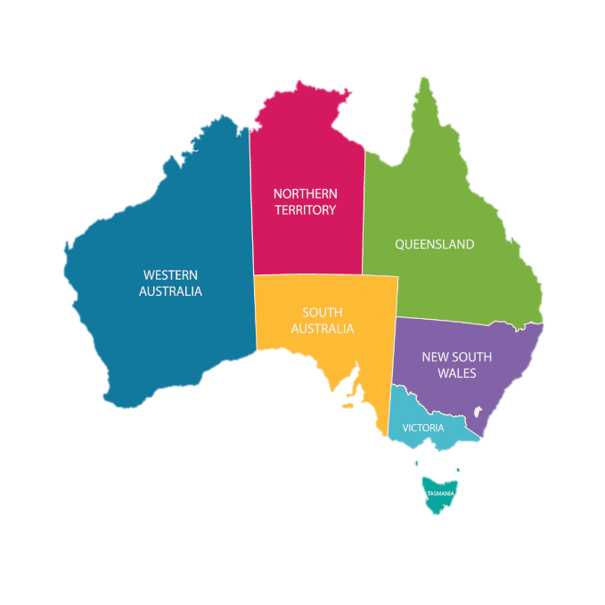
National course comparison website: www.courseseeker.edu.au
TISC
www.tisc.edu.au
QTAC
www.qtac.edu.au
UAC
www.uac.edu.au
SATAC (+NT)
www.satac.edu.au
VTAC
www.vtac.edu.au
UTAS
www.utas.edu.au
Notes:
If you’re thinking of studying interstate, there are links from our website to similar organisations in other states. Each will have its own deadlines, procedures and fees, so we recommend you check these carefully. Go to: http://www.tisc.edu.au/static/guide/interstate.tisc
CourseSeeker is a useful resource if you want to compare similar courses across different institutions, including interstate.

Slide 49
Important Dates – 2025/26
Subject to change – check TISC website for updates
3 June 2025 | Applications open
Early July | TISC Guide published
31 August | Final closing date for Vet Science at Murdoch
1 September | First round of Early Offers
30 September | Final closing date for Medicine/Dentistry (Curtin/UWA/UNDA)
28 November | Closing date for EAS applications/documents (main round)
19 December | ATARs and scaled scores released for WACE students
20 December | Applications/preference changes close for main round
24 December | Main round offers released – applications re-open
9 January | Final closing date for EAS applications/documents
14 January | Applications/preference changes close
19 January | Second round offers released
Notes:
Here are some dates that will be relevant to you this year.
Make sure you get an application submitted by 11.59 pm on the 30th of September, so you have access to all the available courses. Some courses have firm closing dates, so make sure you don’t leave it too late.
The good thing is, you can change your preferences as many times as you like until just before the major offer rounds, which happen after Year 12 results come out. So, you’re not locked into anything too early. You’ll even have time to reconsider your preferences after you get your results and again in between the offer rounds.
This year, there will be two major offer rounds, one just before Christmas and one in January. This year, there is not much time between ATARs being released and the closing date for main round, so it’s a good idea to think about your preferences beforehand. We’ll talk more about that later.
You’ll have plenty of time to change your preferences between the offer rounds, if you change your mind about what you want to study.
Please note that these dates are subject to confirmation closer to the time.

Slide 50
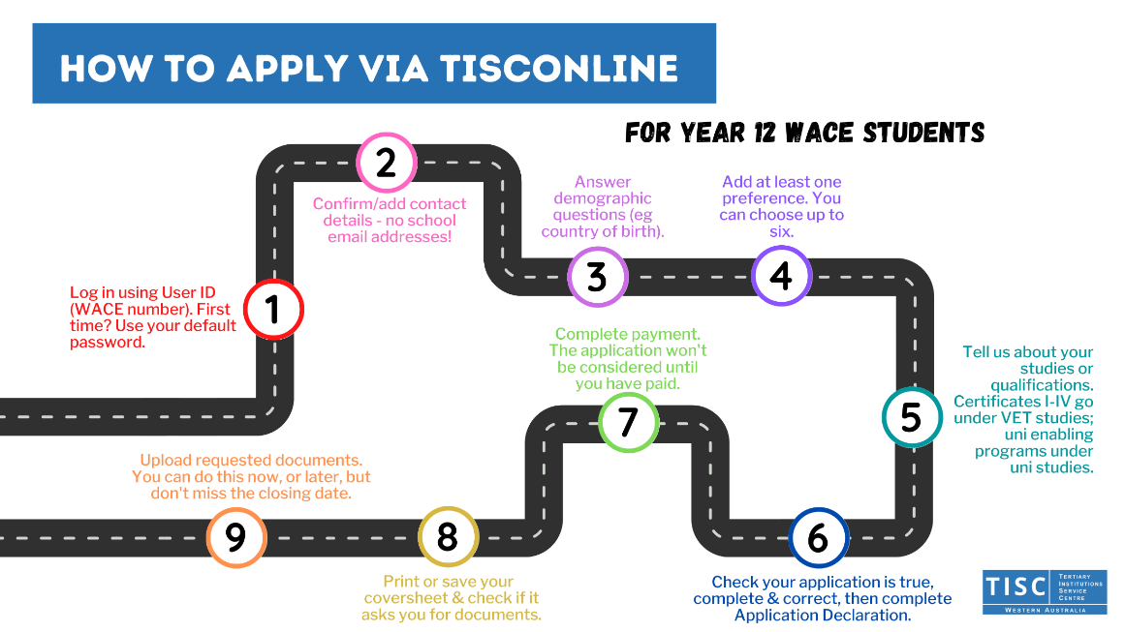
$95
Notes:
Here’s a road map to completing your TISC application. First, as Year 12 students, you’re ALL pre-registered with our website, so please log in using your WACE number. There’s information on TISCOnline to work out what your default password is. Next, you add or confirm contact details and answer some demographic questions.
Now, it’s time to add your preferences – more information on that next!
Tell us about your studies or qualifications. We receive your ATAR and General subject enrolments from the School Curriculum and Standards Authority, but if you’re studying a VET certificate, an enabling program or something else you want to use towards entry, we can’t see these, so you must tell us as part of your application.
Once your application is finished, complete the declaration and then you need to pay in order for your application to be considered. For 2026 admission the fee is $95.
Print or save your Application Coversheet, and if you need to submit documents you can do this now, or log back in at any time (subject to closing dates) and upload it later.

Slide 51
Online Application – Tips
Don’t forget your qualifications – ATAR or General subjects are automatically available, but any VET qualifications, university enabling programs etc must be declared by you.
Additional submissions – some courses require things like a declaration or statement. TISC will advise you of these, either during the application process or by email.
Don’t use a school email address.
Please provide at least one phone number, preferably a mobile phone.
Notes:
As mentioned on the previous slide, please tell us about any qualifications you are studying, even if you haven’t completed them yet. We may be able to get your final results directly (eg from the university or TAFE), or you may have to upload a document once it’s complete. This includes enabling programs like UniReady, UniPrep Schools, TLC Learning for Tomorrow, FlexiTrack High or UniPath.
On the subject of supporting documents, some courses require additional submissions like a declaration or statement – for example, nursing and teaching courses. Check your email regularly to make sure you know what’s required. Also check your Application Coversheet as this may request documents in some cases – like your Certificate IV.
Please don’t use a school email address. The universities will use the email address you provide to notify you of your offer in January. Your school email account might be closed by then. Use an address you’ll be using after school, then we can make sure that you get all the info you need.

Slide 52
Preferences
Preference | Course | University
1 | Dream course 1 | University A
2 | Dream course 2 | University B
3 | Confident choice 1 | University C
4 | Confident choice 2 | University D
5 | Fall back choice 1 | University A
6 | Fall back choice 2 | University C
Notes:
You can choose up to six course preferences. These can all be at the same university or can be from one or more universities. You don’t have to use up all six preferences, but make sure you use enough to keep all your options open. The preference system is designed to work for your benefit.
We often get asked how people should structure their preferences. You should just list your preferences in order from the one you wish to do most, down to the one you wish to do least. Of course, don’t put down a course that you’d actually hate to do!
Because you’ve got six preferences, you can afford to go for broke with your first couple of choices. You’ll not be disadvantaged in any way if you don’t get an offer for your highest preferences. We’ll keep working down your preference list until we get to the highest possible preference we can offer to you.
Always list your dream course/s right up the top, even if you don’t think you are likely to receive an offer – if it isn’t on your list, you definitely won’t!

Slide 53
Preferences
Preference | Course | University
1 | Dream course 1 | University A
2 | Dream course 2 | University B
3 | Confident choice 1 | University C
4 | Confident choice 2 | University D
5 | Fall back choice 1 | University A
6 | Fall back choice 2 | University C
Notes:
In the middle, place a couple of confident choices – courses that you are fairly confident, if things go to plan, you’ll meet the requirements for.

Slide 54
Preferences
Preference | Course | University
1 | Dream course 1 | University A
2 | Dream course 2 | University B
3 | Confident choice 1 | University C
4 | Confident choice 2 | University D
5 | Fall back choice 1 | University A
6 | Fall back choice 2 | University C
Notes:
It’s also worth considering a fall back choice or two, just in case things don’t go as you hoped and you don’t end up meeting the requirements of your Confident Choices. Depending on your situation, a fall back choice might be a course that has a guaranteed ATAR of 70, or an enabling program.

Slide 55

Method of Study & Entry
Pref # | Course | University | Experience Based Entry? | Method of Study
1 | Engineering | University A |  | Full-time
2 | Engineering | University B |  | Full-time
3 | Science | University A |  | Full-time
4 | Science | University B |  | Full-time
5 | Enabling Program | University A |  | Full-time
6 | Enabling Program | University B |  | Full-time
Notes:
Once you’ve added the course codes for your preferences, there are a couple of other selections you need to make. You need to choose your preferred method of study – many courses are offered part-time or externally as well as full-time, but not all are. The TISC course search will tell you which methods of study a particular course offers, and you won’t be able to select a method of study that isn’t offered for that particular course code.
A feature that TISC introduced last year, is to allow you to indicate whether or not you wish to be considered for Experience Based Entry (sometimes called Portfolio Entry) for one or more of your preferences. This option will only be available to select if that course code offers an experience based entry pathway.
In our example here, the applicant’s dream courses are engineering, which generally don’t offer experience based entry options. The next choices are a Bachelor of Science, which both University A and University B offer with experience based entry. Enabling programs generally don’t offer experience-based entry as their entry requirements are already inclusive of non-ATAR pathways or lower ATARs.
Selecting the experience based entry option does not mean your ATAR won’t be considered, but you are telling the university that if your ATAR doesn’t meet the requirements, you would also like to be considered for experience based entry for that course. Experience based entry pathways will involve submitting additional documentation, so you should check with the university what is required.
If you end up meeting the guaranteed ATAR requirements, you will be made an offer based on your ATAR, even if you have selected Experience Based Entry.

Slide 56

TISC will offer you the highest possible preference.
Notes:
The thing to remember is that TISC’s system will give you the highest preference possible. If you sell yourself short and put your dream course as a low preference, and ‘safe’ choices as your higher preference, of course you’re going to get an offer for the safe course at the higher preference position.
What you wouldn’t know is whether or not you might just have gotten an offer for your dream course, if it had been placed as a higher preference.

Slide 57
Results
(for WACE ATAR students)
Notes:
Here’s some information on how you’ll get your results and what to look for when you get them.

Slide 58
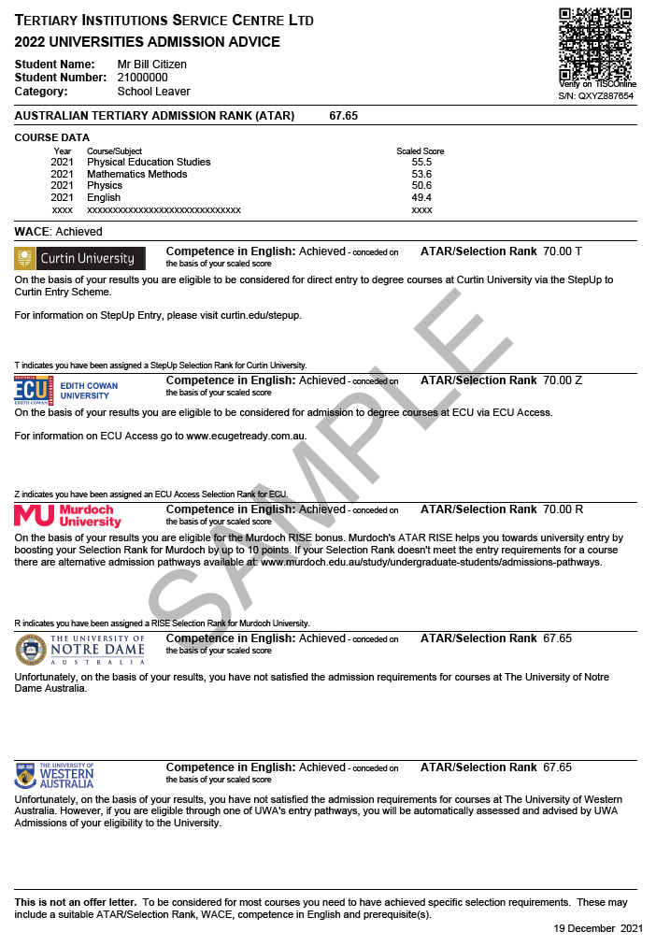
QR CODE
If you have completed one or more ATAR subjects you will be issued a Universities Admission Advice Letter (UAAL). It will look something like this.
Notes:
If you’ve completed at least one ATAR course, when you log into your TISC account after results have been released, you’ll be directed to a page where you can open (and download if you wish) a personalised pdf of your results. This is the Universities Admissions Advice Letter (or UAAL).
Not all Year 12s get issued a UAAL. You only get a UAAL if you’ve completed at least one ATAR course.

Slide 59
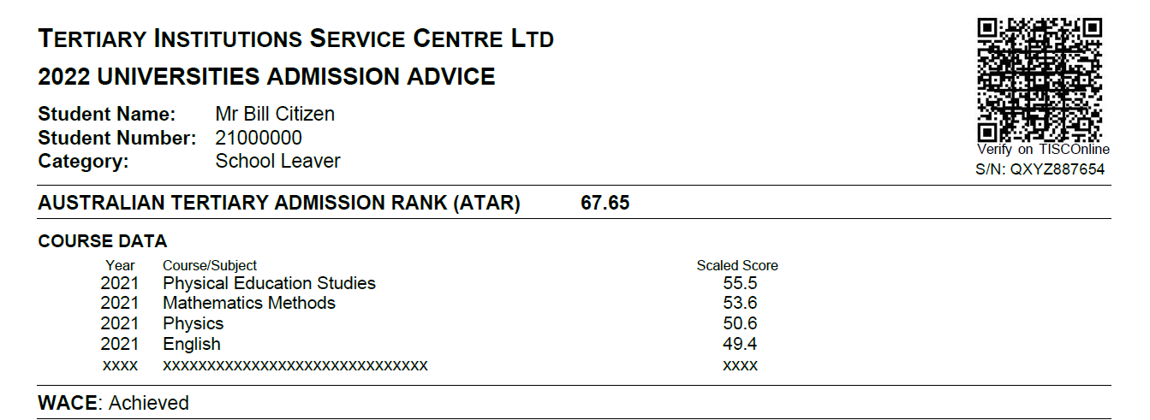
QR CODE
All your current-year scaled scores will be shown. Previous years’ scaled scores will only be shown if they are in your best four.
Notes:
Some things to look for:
Your ‘raw’ ATAR will be shown at the top. This is the ATAR you would use if you were applying interstate.
We also show you your scaled scores. The School Curriculum and Standards Authority website can show you some of the ‘interim’ scores (like your raw exam mark, your moderated school assessment and your unstandardised combined score) so you can trace the transformation from raw marks to scaled scores. In most cases, all your scaled scores will show here, even if they’re not included in your best four. In a small number of cases where a student completed one or more ATAR courses the previous year (for example a current Year 12 who sat a Year 12 subject in Year 11 the previous year, or a student repeating Year 12), some of your previous years’ scores may not show due to space constraints.
Your UAAL will also show if you have achieved WACE. If that says ‘Not Achieved’ and you think you should have achieved WACE, you should contact SCSA urgently. Not achieving WACE may prevent any offers being made to you.

Slide 60
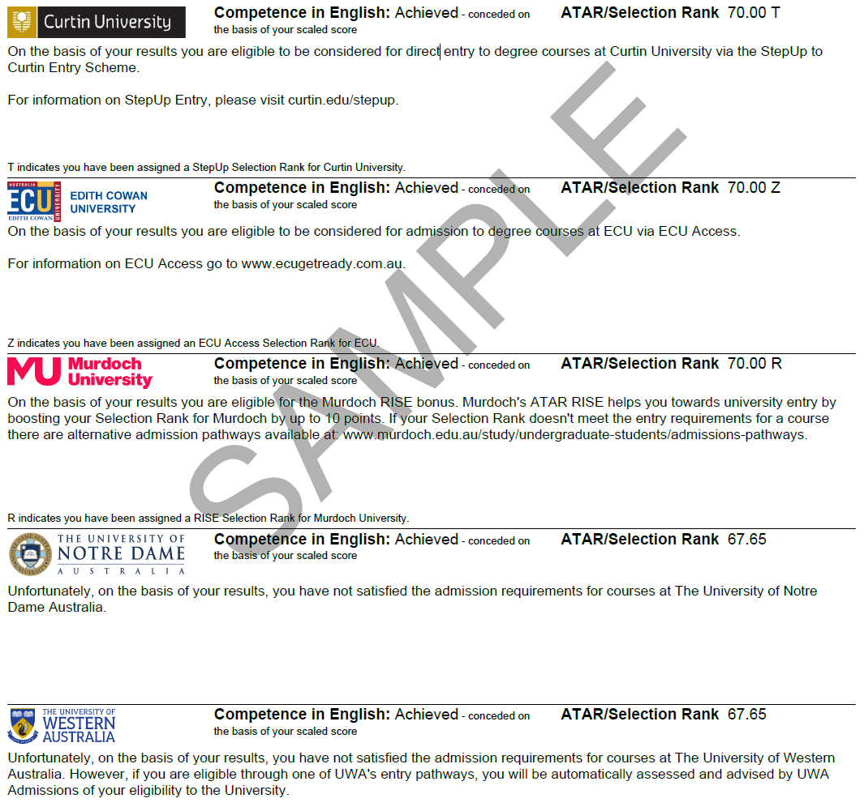
These messages are only based on your ATAR/Selection Rank. You may satisfy admission requirements in other ways, but these won’t show on your UAAL.
Notes:
There’s lots to see on the bottom half of the UAAL. This is information specific to each university, so make sure you read it carefully.
If you’re eligible for any adjustment factors (bonus points) from a university, they’ll be reflected in that university’s section on the letter. In this example, you can see that the original ATAR of 67.65 has evolved into a couple of different Selection Ranks for particular universities. This is the rank the university concerned will use in comparing you against other applicants. Where an adjustment factor has been applied, the footnotes in each section tell you why. Notre Dame assesses adjustment factors individually, so this may not be reflected on your UAAL.
You should check carefully the Competence in English indication. If it says ‘Achieved’ for a particular university that’s great. If it says ‘Not Achieved,’ you may be eligible to sit the 2nd chance English test to satisfy the requirement.
Remember, these messages are based solely on your performance in ATAR subjects. If you satisfy admission requirements in some other way, the universities will be aware of this but it will not show on your UAAL. For example, a student completing a Certificate IV and also studying ATAR English will receive a UAAL which will show their English scaled score. The UAAL messages will state that they are not eligible for courses at any university, but in actual fact, if their Certificate IV has been verified as complete, and they’ve achieved English competency, they will be eligible for a wide range of courses at most of the universities.
Also read each universities’ individual message to you. There might be some tips there on alternative pathways for you, or other important information.
We always recommend that you download and print a copy of your UAAL, so you and your parents can go over it carefully. If you want an official copy to keep, you can order them on our website.

Slide 61

Early Offers
The first round of Year 12 Early Offers will be on Monday 1 September, followed by Monday 22 September, Monday 13 October, Monday 24 November and Wednesday 3 December (dates TBC).
Year 12 Early Offers are expected to be conditional – conditions will vary.
Your TISC application is your Early Offer application – you will automatically be considered for your first preference.
Most Early Offers will be made based on Year 11 results.
Accepting an Early Offer still allows you to change your preferences – but this may invalidate that early offer.
Notes:
A Federal Government review last year recommended that early (at-school) offers to Year 12 students should not be made any earlier than September. For this reason, the WA universities have decided not to commence making early offers for 2026 entry until Monday 1st September 2025.
We expect there will be five rounds of early offers, with none made during the WACE examination period. We also expect that Year 12 early offers will be conditional – that is there will be certain things you must achieve or must do in order to hold on to that early offer. Those conditions may include achieving your WACE, passing English or other subjects, or achieving a certain ATAR.
You don’t need to apply separately for an early offer, but only the first preference on your TISC application will be considered. This is different to the main and second round of offers, where all your preferences are looked at. Sometimes, the conditions of an early offer include that it remains your first preference.
Even though early offers are starting later, most will still be made based on your Year 11 results because that’s the most reliable, readily available data that we have.

Slide 62

Main & Second Round Offers
TISC offers are usually unconditional, but may be conditional – read the fine print.
You will have a chance to change preferences between main and second rounds unless you accept your offer – accepting your offer locks your application.
Check the TISC Guide and TISC website for more information on responding to offers including the TISC Safety Net.
If you get no offer, use the time between offer rounds to work out why & make any required changes.
Notes:
This presentation doesn’t go into a lot of detail on offers, because it’s so early in the year.
Many of the universities now give early offers to Year 12 students. These are usually conditional – that is, you might still need a particular ATAR, or to pass Maths, or just to achieve WACE – so read them carefully. Also remember that they don’t lock you in, even if you accept them.
Offers made through TISC are usually unconditional, but read your offer letter carefully in case.
Check the TISC Guide and website closer to the time for more information on responding to offers.

Slide 63
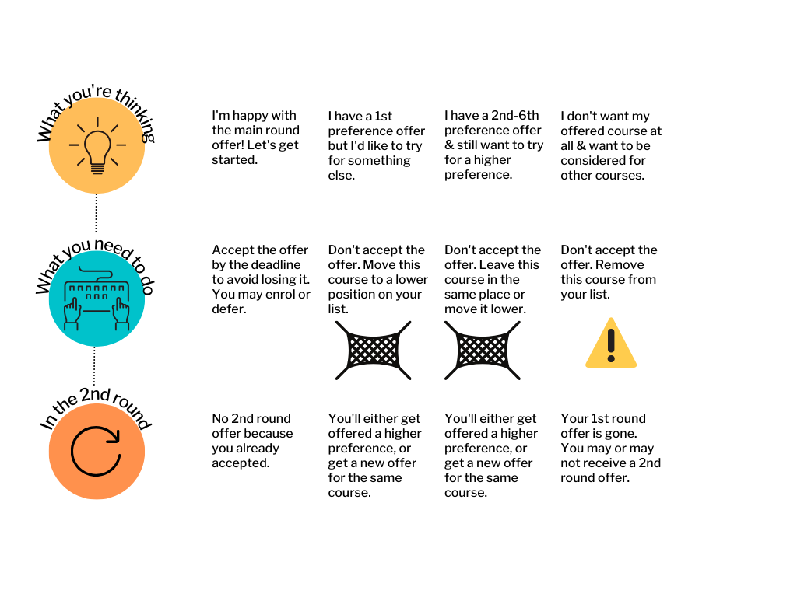
Main Round Offers & the TISC Safety Net
Notes:
If you are offered your first preference in the main round, you need to either accept, or change your preference order, otherwise you may lose that offer.
However, if you are offered a lower preference in the main round, you can use the automatic TISC Safety Net – don’t accept the offer, and in the second round you’ll either be re-offered the same course, or be offered a higher preference – you can’t lose!

Slide 64

No Main Round Offer
Seek advice
Fix any problems and wait for the second round
Change preferences
Do nothing and hope for a second round offer
It’s easier for TISC to help you work out what the problem is if you contact us after main round.
Notes:
What if you don’t get an offer in the main round?
You might know why – and the following slide will summarise some common reasons why – in which case, the best thing to do is to fix the problem, if possible, and then wait for second round. You may also need to consider changing preferences.
You can do nothing and hope for a second round offer, but in most cases, whatever stopped you from getting an offer in the main round, will continue to stop you from getting an offer in the second round, if nothing changes.
So if you have any doubt or questions about why you didn’t receive an offer or how to improve your chances of an offer for the second round, please contact TISC or the universities for advice. It’s much easier for us to help you work out the solution if you contact us as soon as possible after the main round. If you wait, especially if you wait until after the second round, it can be much more difficult to help you.

Slide 65
Problems
English Language competency not achieved
Minimum Selection Rank not met
Quota course, Selection Rank not competitive
Prerequisite not met
Additional submissions not completed
Sit STAT or change preferences
Change preferences, consider alternative pathways
Add preferences, consider pathway courses
Add/change preferences, consider pathway courses
Submit the documents before 2nd round deadline
Solutions
Notes:
These are some of the most common reasons for Year 12 students not receiving an offer through TISC.
English Language competence may not have been achieved, in which case you may be able to book for the STAT Written English, or another English test – check with the university where you want to study.
All courses have a minimum selection rank, and if you didn’t quite achieve that, you won’t be offered a place. You may wish to consider alternative entry pathways.
Some courses, for example Nursing, can only offer a certain number of places, so some applicants who have a selection rank above the minimum, may still miss out if their rank is not competitive. Again, you may wish to consider pathway courses that have Guaranteed ATARs, like Health Sciences.
Some courses have prerequisites and if you didn’t get a scaled score of 50 in that pre-requisite you won’t be offered a place. Check with the university where you want to study, what you should do next.
Earlier on, I mentioned additional submissions for some courses. Sometimes, not completing these correctly can mean you don’t get offered a place in a course even if you meet all other requirements. That’s why it’s really important to check your email.

Slide 66
Alternative Pathways
If you don’t meet minimum university entry
If you meet minimum entry, but not the requirements for your dream course
Enabling programs
Experience Based Entry and/or portfolio entry schemes
TISC Associate Members may have more flexible entry requirements
University pathway/Higher Ed Diplomas
TAFE or other VET providers
Ask the university for advice – they can usually suggest a ‘pathway’ course where you can study similar units and apply to transfer after a year.
Notes:
There are two main scenarios that may occur for you to be looking at alternative pathways.
First, if you don’t meet minimum university entry (often 70, or 75 for UWA). You might look at enabling programs, portfolio or experience-based entry pathways, or other education providers like TISC Associate Members, university pathway colleges, TAFE or other VET or higher education providers. These can all provide you with a pathway to a university degree.
Some of you may meet minimum university entry, but not the requirements for your dream course. This is where your best option is to ask the university where you want to study for some advice. They can suggest “pathway” courses. For example, you might want to study Engineering but not quite achieve the required ATAR, or meet the maths pre-requisite. If you go to your preferred university and explain it to them, they may suggest you start off in a Technology or Science degree and pick up particular bridging units. Usually, after a year, you can apply to transfer internally and get credit for the units you have completed.

Slide 67
Deferral – A Gap Year
Most courses can be deferred.
A small number can’t – the university will advise you of this.
Deferral is usually for 12 months but can be for 6 or 24 months depending on course availability.
A deferral is an acceptance of your offer – you are saying you definitely want this place, but you don’t want to start in Semester 1 2026.
The university will contact you about your deferred place in the second half of 2026.
You will always have the option to change your mind and not study, or apply for a different course.
Notes:
Some students choose to defer their course offer. Most courses can be deferred – if yours is one of the small number which can’t, the university will advise you.
Remember, a deferral is an acceptance of your offer. You are saying you want this place, but don’t want to start for a period of time, usually 12 months but sometimes 6 months or even two years.
The university will then contact you about your deferred place in the second half of the following year to check if you still want the place. If you don’t, you still have the option to change your mind.

Slide 68
Where Can I Find More Information?
TISC Guide
Admission Requirements brochures
TISC website
University websites and prospectuses
Open Days
Notes:
We know that some of you will have questions as you go through the rest of this year, and luckily there are plenty of places to go for more information. The TISC Guide will be available electronically in July this year.
The Admission Requirements brochures on the TISC website go into detail about prerequisite and recommended subjects for all degree courses. As mentioned earlier, the TISC website is a great source of information, as well as the university websites and their prospectuses, which are also issued in hard copy.
All universities have open days coming up – check out their websites for more details.

Slide 69
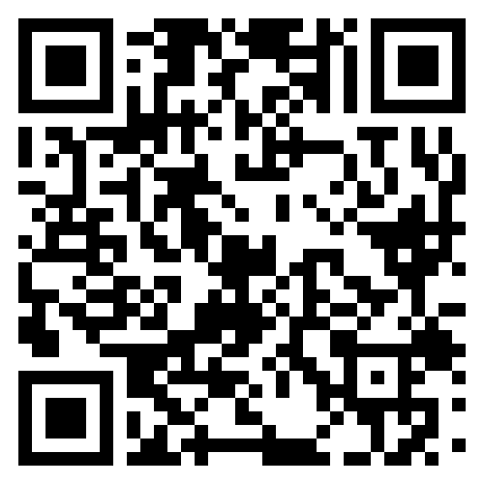
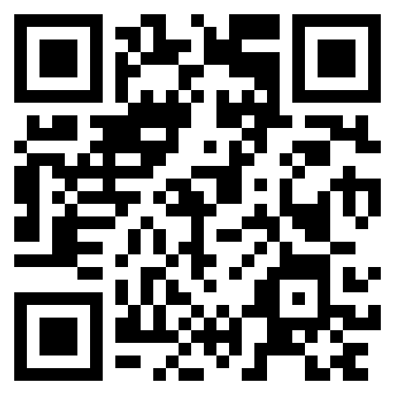
Contact us
Keep up to date on socials
9318 8000
info@tisc.edu.au
www.tisc.edu.au
Instagram
Facebook
Notes:
Please, if you have any questions whatsoever during the year, never hesitate to make contact with TISC or with the universities directly.
There are many people at your school, at TISC, at SCSA and at the universities, who will be happy to clarify anything that’s confusing to you.
Our phone lines are open 9am to 4.30pm Monday to Friday, and you can email us at any time. We generally will respond quickly, as we know this is important to you. Please, don’t have your parents phone on your behalf, we can’t give them information about your application.

Slide 70
Notes:
Everyone here at TISC wishes you every success in the rest of your Year 12 studies and your future plans.

